Slide 1
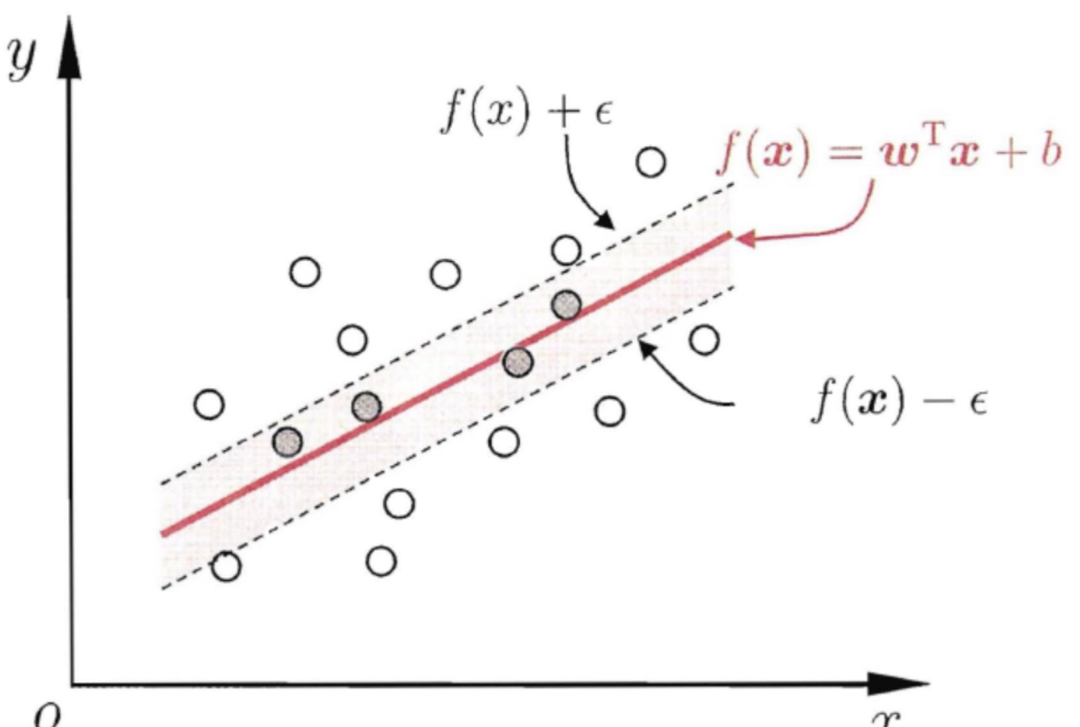
An Open Problem in Constrained Support Vector Regression
By: Denis O’Byrne
AMS 522 Stony Brook University

Slide 2
Support Vector Regression
Support-vector machines (SVMs, also support-vector networks) are supervised learning models with associated learning algorithms that analyze data for classification and regression analysis
, SVMs can efficiently perform a non-linear classification and regression using what is called the kernel trick, implicitly mapping their inputs into high-dimensional feature spaces
Kernel functions enable them to operate in a high-dimensional, implicit feature space without ever computing the coordinates of the data in that space, but rather by simply computing the inner products between the images of all pairs of data in the feature space
Computationally cheaper than the explicit computation of the coordinates

Slide 3
Objective
Through the use of kernel functions, I will be presenting an open problem in Support Vector Regression with the necessary tools needed to solve such a problem
Problem will be to convert constrained Support-Vector Regression problems into standard SVR problems with an updated kernel choice
Solution would make solving constrained optimization problems easier to solve, as currently every additional constraint leads to exponential increases in computation time.
Problem was suggested by Ph.D. Chris Bemis of the University of Minnesota

Slide 4
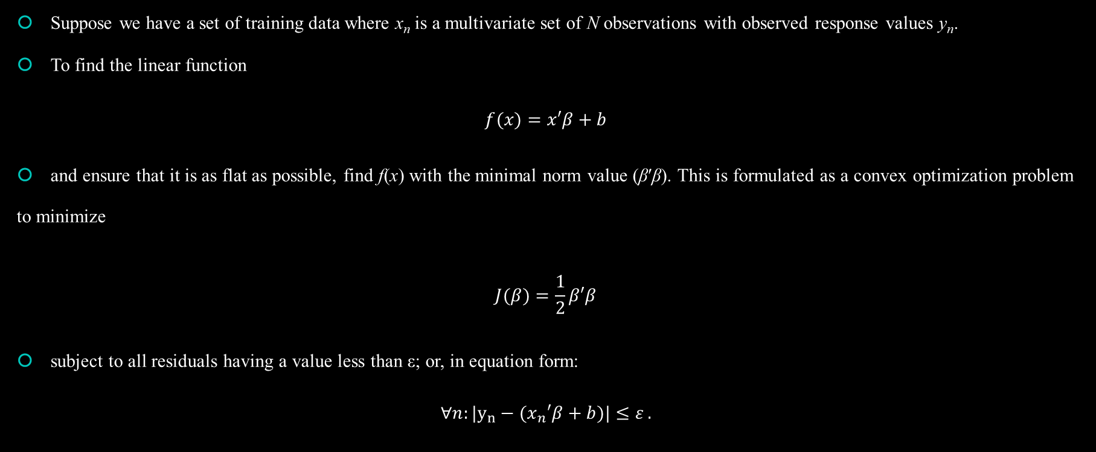
Standard Support-Vector Regression
Suppose we have a set of training data where x_{n} is a multivariate set of N observations with observed response values y_{n}.
To find the linear function
$$f(x)=x′β+b$$
and ensure that it is as flat as possible, find f(x) with the minimal norm value (β′β). This is formulated as a convex optimization problem to minimize
$$J(β)=\frac{1}{2}β′β$$
subject to all residuals having a value less than ε; or, in equation form:
$$∀n:|y_{n}−(x_{n}′β+b)|≤ε .$$

Slide 5
SVR Continued
It is possible that no such function f(x) exists to satisfy these constraints for all points
To deal with otherwise infeasible constraints, introduce slack variables ξ_{n} and ξ*_{n} for each point
This approach is similar to the “soft margin” concept in SVM classification, because the slack variables allow regression errors to exist up to the value of ξ_{n} and ξ*_{n}, yet still satisfy the required conditions

Slide 6
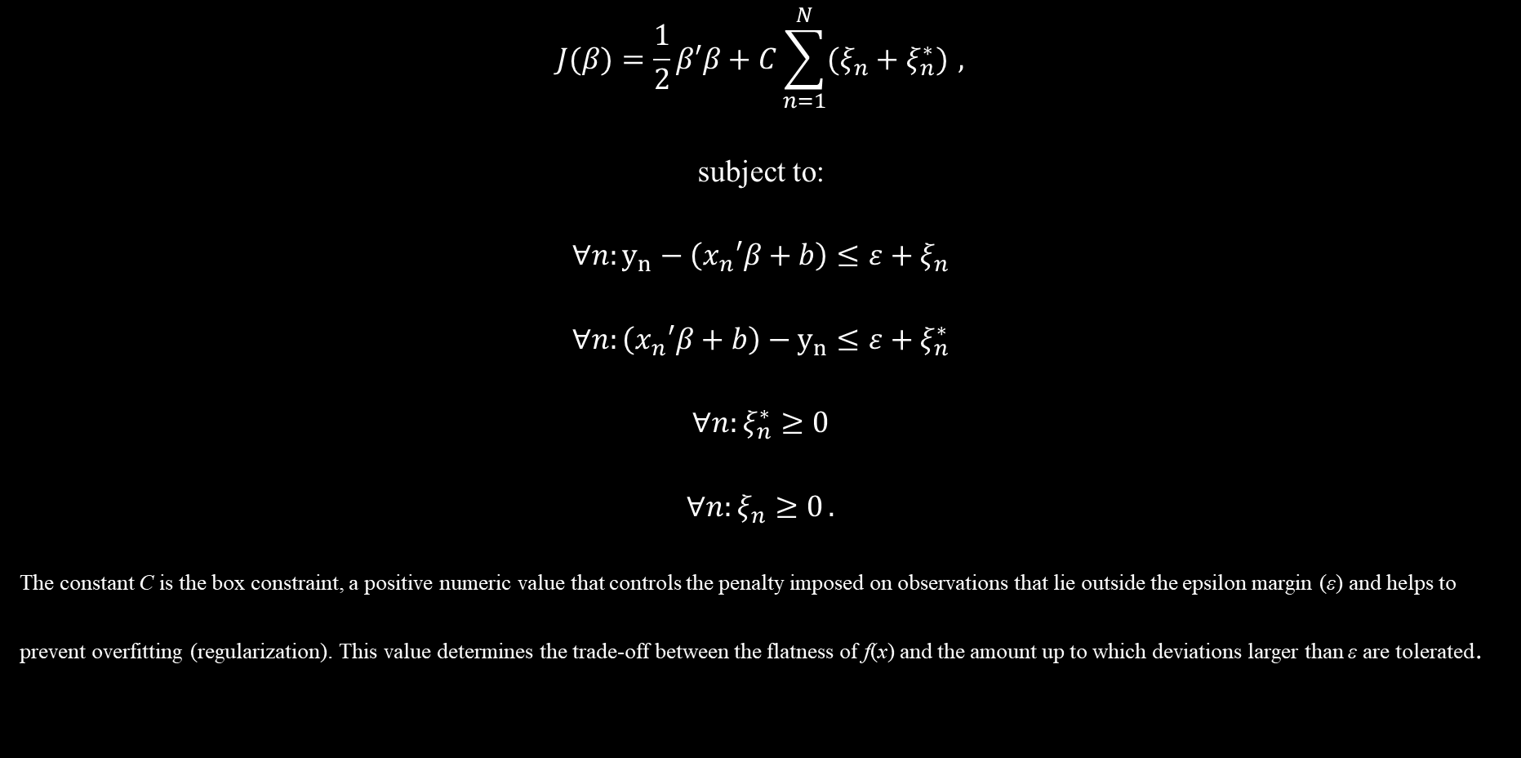
Slack SVR Primal Problem
$$J(β)=\frac{1}{2}β′β+C\sum_{n=1}^{N}{(ξ_{n}+ξ_{n}^{∗})} ,$$
subject to:
$$∀n:y_{n}−\left(x_{n}′β+b\right)≤ε+ξ_{n}$$
$$∀n:\left(x_{n}′β+b\right)−y_{n}≤ε+ξ_{n}^{∗}$$
$$∀n:ξ_{n}^{∗}≥0$$
$$∀n:ξ_{n}≥0 .$$
The constant C is the box constraint, a positive numeric value that controls the penalty imposed on observations that lie outside the epsilon margin (ε) and helps to prevent overfitting (regularization). This value determines the trade-off between the flatness of f(x) and the amount up to which deviations larger than ε are tolerated.

Slide 7
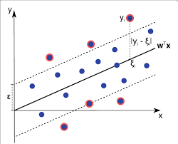

Slide 8
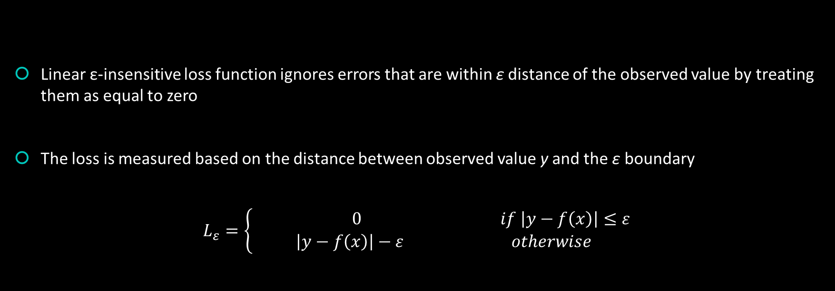
Hinge Loss
Linear ε-insensitive loss function ignores errors that are within ε distance of the observed value by treating them as equal to zero
The loss is measured based on the distance between observed value y and the ε boundary
$$L_{ε}=\left\{\begin{aligned} 0 if \left|y−f\left(x\right)\right|≤ε \\ \left|y−f\left(x\right)\right|−ε otherwise\end{aligned}\right.$$

Slide 9
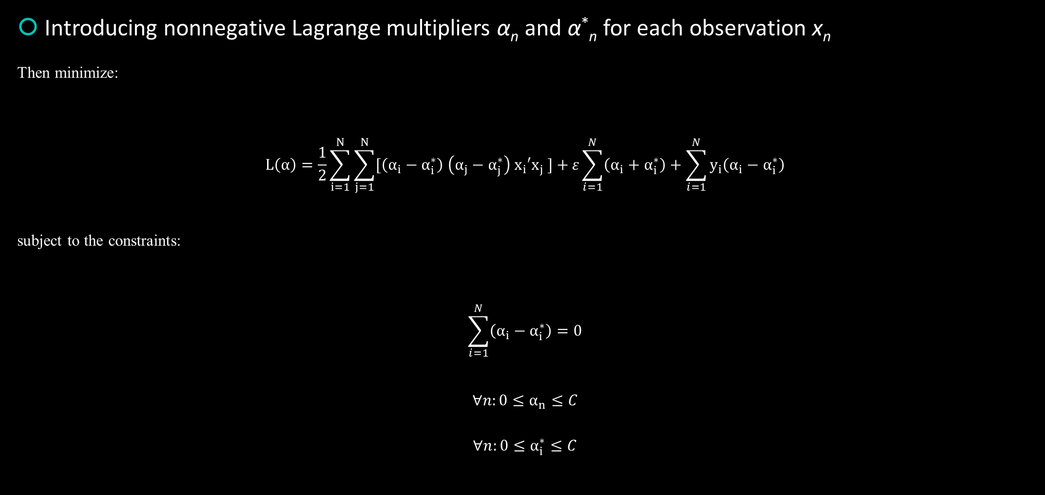
Linear SVM Regression: Dual Formula
Introducing nonnegative Lagrange multipliers α_{n} and α*_{n} for each observation x_{n}
Then minimize:
$$L\left(α\right)=\frac{1}{2}\sum_{i=1}^{N}{\sum_{j=1}^{N}{[\left(α_{i}−α_{i}^{∗}\right) \left(α_{j}−α_{j}^{∗}\right) x_{i}′x_{j} ]}+}ε\sum_{i=1}^{N}{\left(α_{i}+α_{i}^{∗}\right)}+\sum_{i=1}^{N}{y_{i}\left(α_{i}−α_{i}^{∗}\right)}$$
subject to the constraints:
$$\sum_{i=1}^{N}{\left(α_{i}−α_{i}^{∗}\right)}=0$$
$$∀n:0≤α_{n}≤C$$
$$∀n:0≤α_{i}^{∗}≤C$$

Slide 10
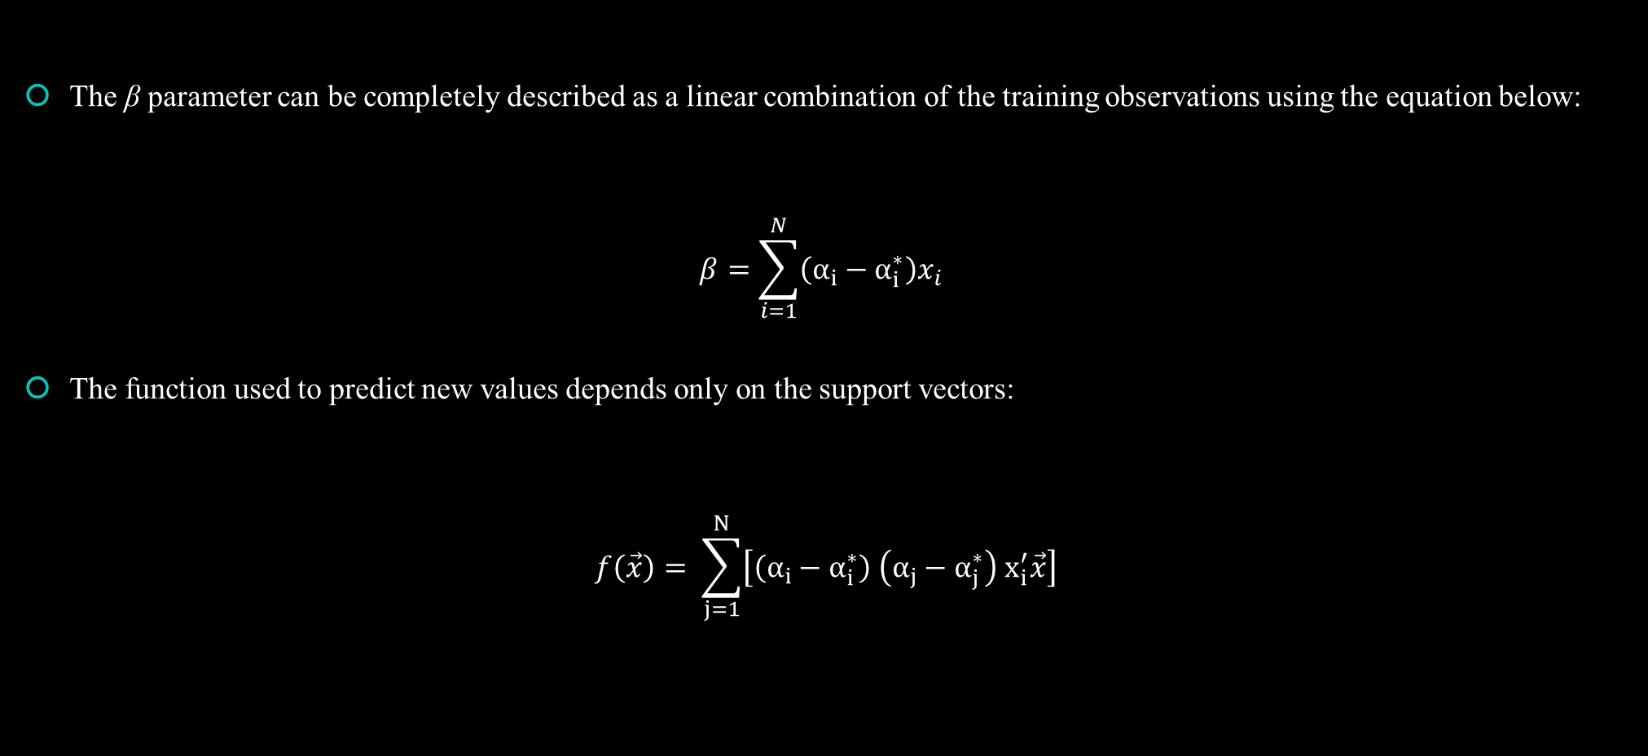
SVR Prediction and Support Vectors
The β parameter can be completely described as a linear combination of the training observations using the equation below:
$$β=\sum_{i=1}^{N}{\left(α_{i}−α_{i}^{∗}\right)x_{i}}$$
The function used to predict new values depends only on the support vectors:
$$f\left(\vec{x}\right)= \sum_{j=1}^{N}{\left[\left(α_{i}−α_{i}^{∗}\right) \left(α_{j}−α_{j}^{∗}\right) x_{i}^{′}\vec{x}\right]}$$

Slide 11
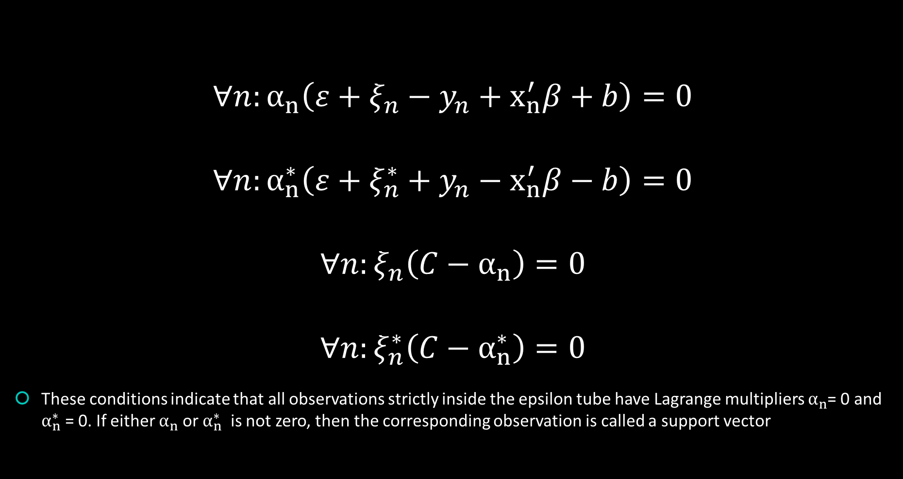
KKT Optimization Conditions
$$∀n:α_{n}\left(ε+ξ_{n}−y_{n}+x_{n}^{′}β+b\right)=0$$
$$∀n:α_{n}^{∗}\left(ε+ξ_{n}^{∗}+y_{n}−x_{n}^{′}β−b\right)=0$$
$$∀n:ξ_{n}\left(C−α_{n}\right)=0$$
$$∀n:ξ_{n}^{∗}\left(C−α_{n}^{∗}\right)=0$$
These conditions indicate that all observations strictly inside the epsilon tube have Lagrange multipliers $α_{n}$= 0 and $α_{n}^{∗}$ = 0. If either $α_{n}$ or $α_{n}^{∗}$ is not zero, then the corresponding observation is called a support vector

Slide 12
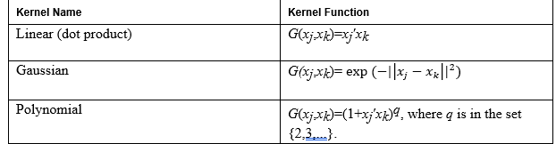
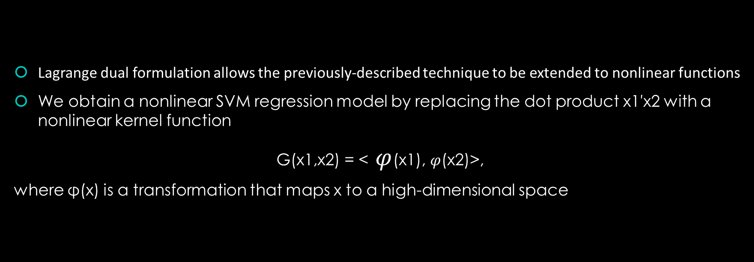
Nonlinear SVM Regression: Primal Formula
Lagrange dual formulation allows the previously-described technique to be extended to nonlinear functions
We obtain a nonlinear SVM regression model by replacing the dot product x1′x2 with a nonlinear kernel function
G(x1,x2) = < $φ$(x1), $φ$(x2)>,
where φ(x) is a transformation that maps x to a high-dimensional space

Slide 13
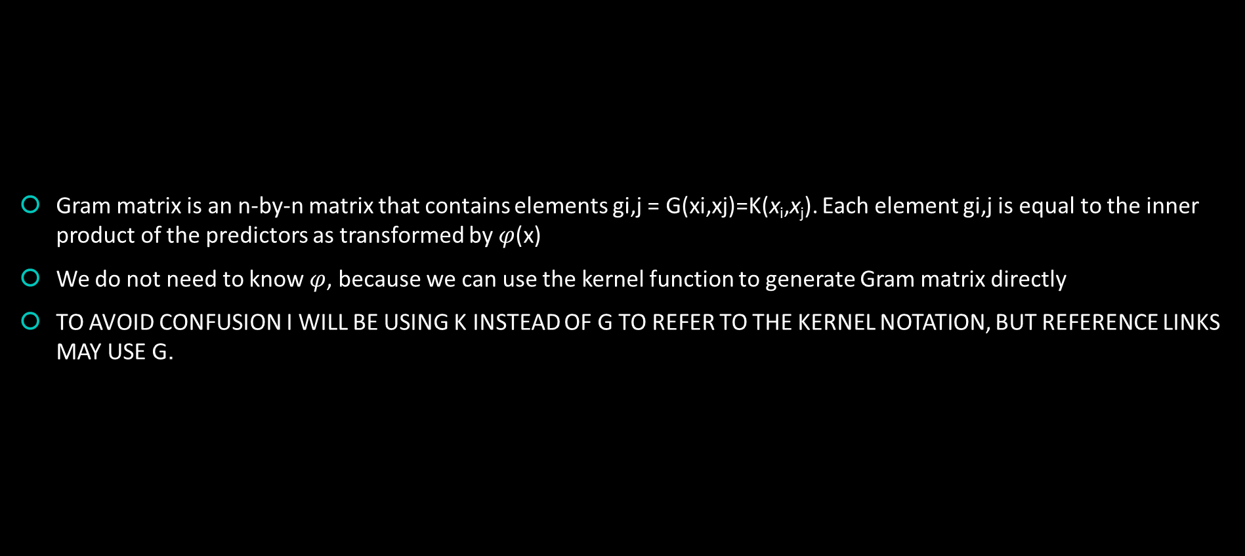
Gram/Kernel Matrix
Gram matrix is an n-by-n matrix that contains elements gi,j = G(xi,xj)=K(x_{i},x_{j}). Each element gi,j is equal to the inner product of the predictors as transformed by $φ$(x)
We do not need to know $φ$, because we can use the kernel function to generate Gram matrix directly
TO AVOID CONFUSION I WILL BE USING K INSTEAD OF G TO REFER TO THE KERNEL NOTATION, BUT REFERENCE LINKS MAY USE G.

Slide 14
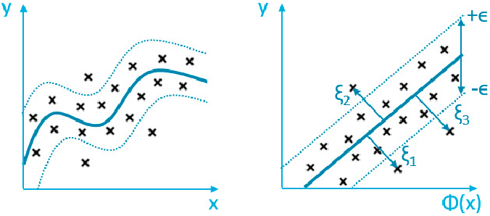

Slide 15
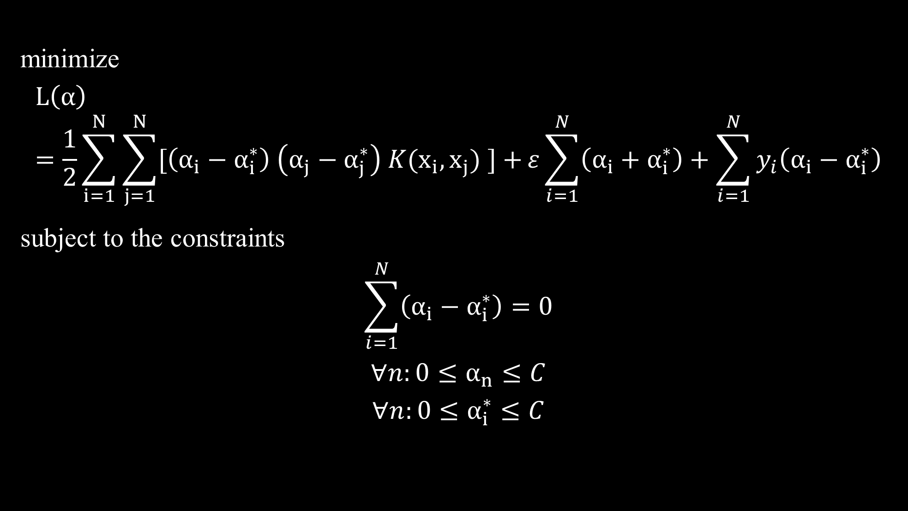
Nonlinear SVM Regression: Dual Formula
minimize
$$L\left(α\right)=\frac{1}{2}\sum_{i=1}^{N}{\sum_{j=1}^{N}{[\left(α_{i}−α_{i}^{∗}\right) \left(α_{j}−α_{j}^{∗}\right) K(x_{i},x_{j}) ]}+}ε\sum_{i=1}^{N}{\left(α_{i}+α_{i}^{∗}\right)}+\sum_{i=1}^{N}{y_{i}\left(α_{i}−α_{i}^{∗}\right)}$$
subject to the constraints
$$\sum_{i=1}^{N}{\left(α_{i}−α_{i}^{∗}\right)}=0$$
$$∀n:0≤α_{n}≤C$$
$$∀n:0≤α_{i}^{∗}≤C$$

Slide 16

Nonlinear Predictions
$$f\left(\vec{x}\right)= \sum_{j=1}^{N}{\left[\left(α_{i}−α_{i}^{∗}\right) \left(α_{j}−α_{j}^{∗}\right)G( x_{i},\vec{x})\right]}$$
Now our support vectors which our predictions are based on are just wrapped in inner products

Slide 17
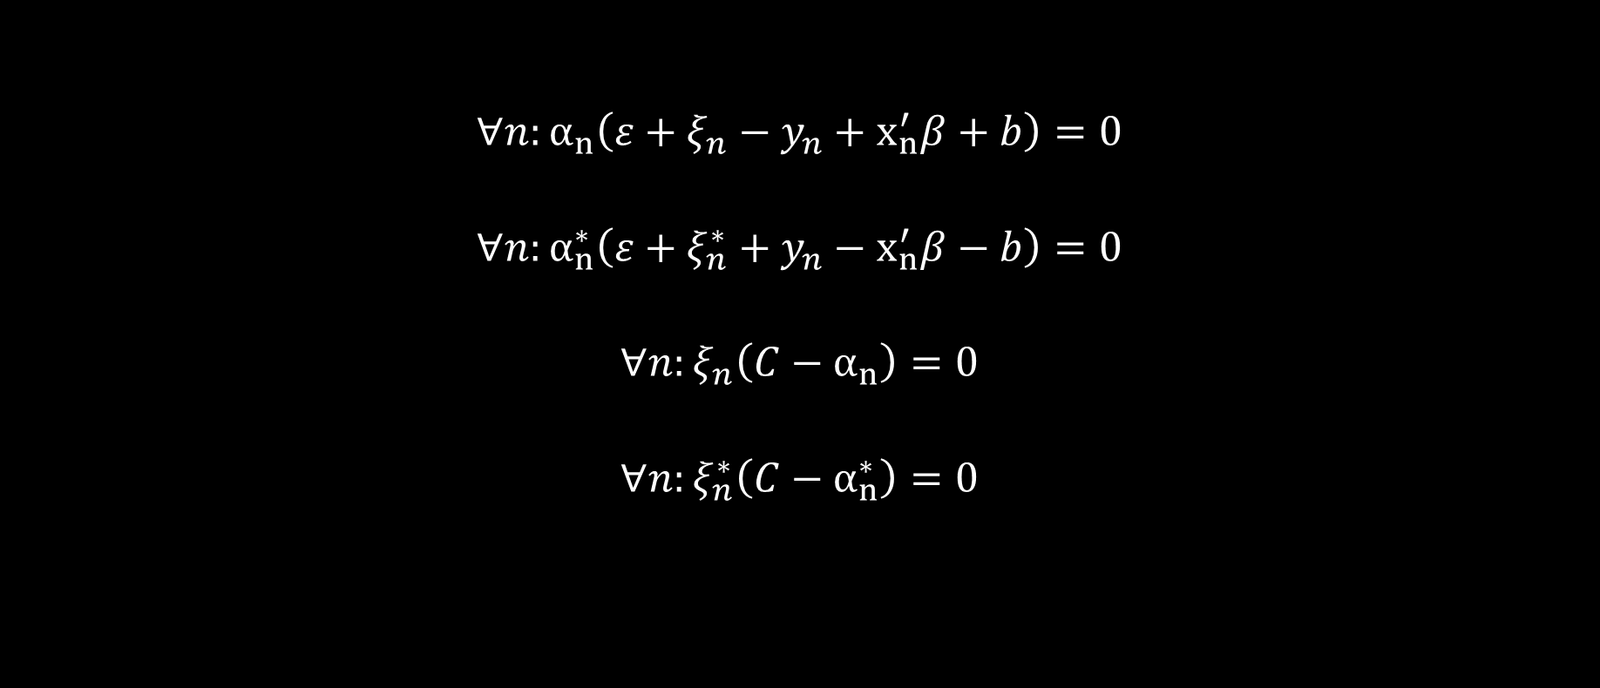
Nonlinear KKT Conditions
$$∀n:α_{n}\left(ε+ξ_{n}−y_{n}+x_{n}^{′}β+b\right)=0$$
$$∀n:α_{n}^{∗}\left(ε+ξ_{n}^{∗}+y_{n}−x_{n}^{′}β−b\right)=0$$
$$∀n:ξ_{n}\left(C−α_{n}\right)=0$$
$$∀n:ξ_{n}^{∗}\left(C−α_{n}^{∗}\right)=0$$

Slide 18
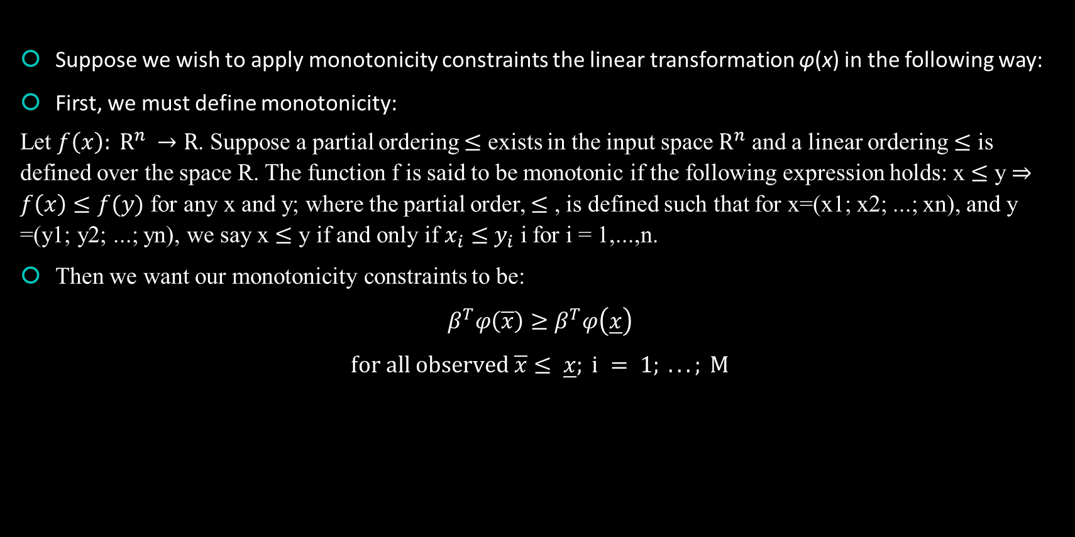
Additional Constraints
Suppose we wish to apply monotonicity constraints the linear transformation φ(x) in the following way:
First, we must define monotonicity:
Let $f\left(x\right): R^{n} →R$. Suppose a partial ordering $≤$ exists in the input space $R^{n}$ and a linear ordering $≤$ is defined over the space R. The function f is said to be monotonic if the following expression holds: x $≤$ y $⇒$ $f\left(x\right)≤f(y)$ for any x and y; where the partial order, $≤$ , is defined such that for x=(x1; x2; ...; xn), and y =(y1; y2; ...; yn), we say x $≤$ y if and only if $x_{i}$ $≤$ $y_{i}$ i for i = 1,...,n.
Then we want our monotonicity constraints to be:
$$β^{T}φ\left(\overline{x}\right)≥β^{T}φ\left(\underline{x}\right)$$
$$for all observed \overline{x}≤ \underline{x}; i = 1; ...; M$$

Slide 19
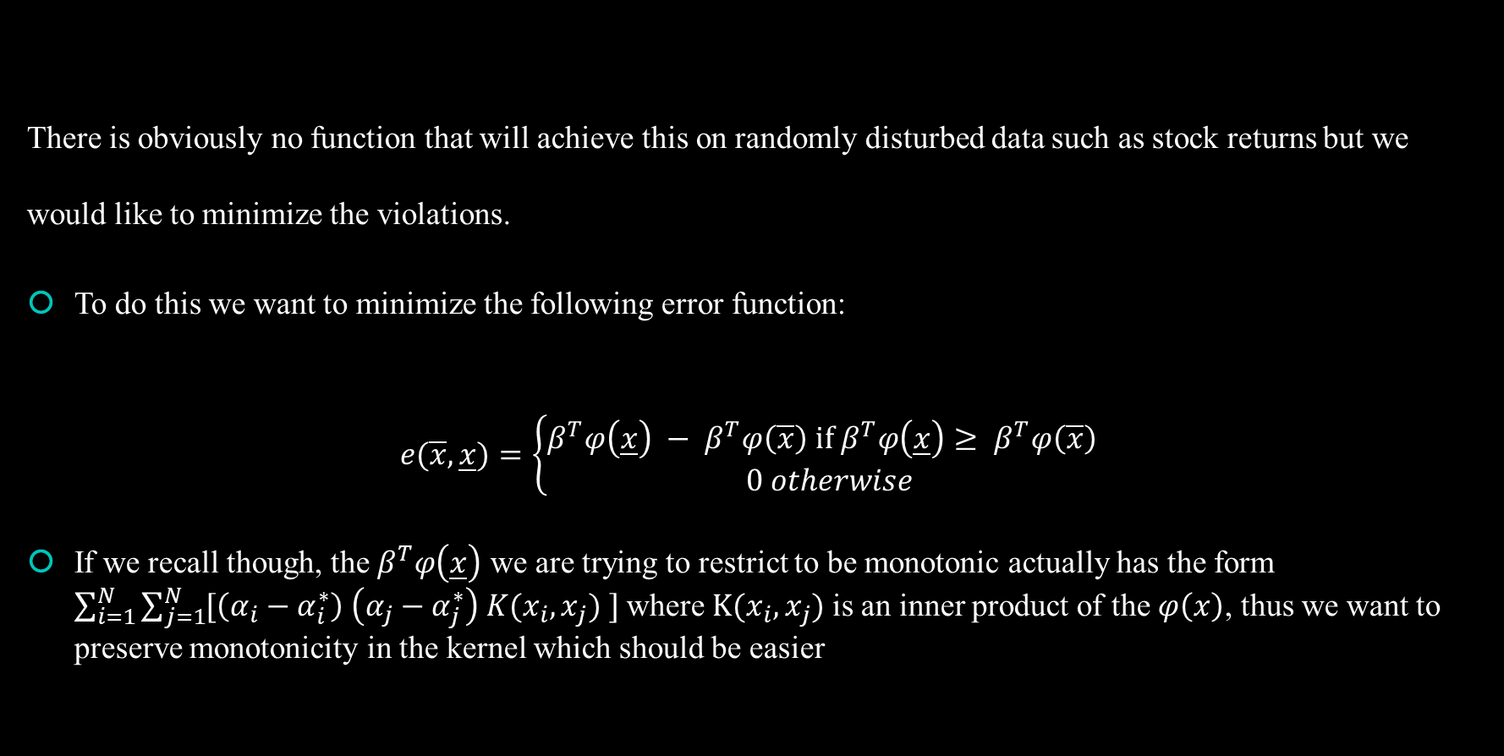
Minimize monotonicity violations
There is obviously no function that will achieve this on randomly disturbed data such as stock returns but we would like to minimize the violations.
To do this we want to minimize the following error function:
$$e(\overline{x},\underline{x})=\left\{\begin{aligned}β^{T}φ\left(\underline{x}\right) − β^{T}φ\left(\overline{x}\right) if β^{T}φ\left(\underline{x}\right)≥ β^{T}φ\left(\overline{x}\right) \\ 0 otherwise\end{aligned}\right.$$
If we recall though, the $β^{T}φ\left(\underline{x}\right)$ we are trying to restrict to be monotonic actually has the form $\sum_{i=1}^{N}{\sum_{j=1}^{N}{[\left(α_{i}−α_{i}^{∗}\right) \left(α_{j}−α_{j}^{∗}\right) K(x_{i},x_{j}) ]}}$ where $K(x_{i},x_{j})$ is an inner product of the $φ\left(x\right)$, thus we want to preserve monotonicity in the kernel which should be easier

Slide 20
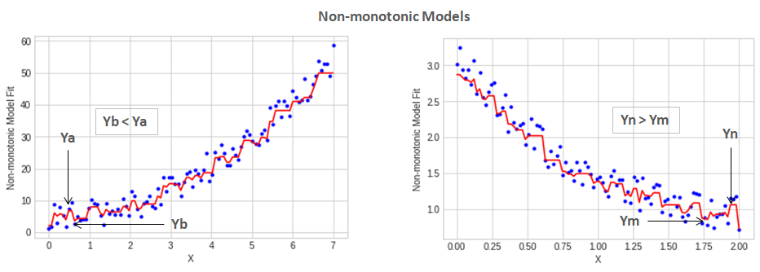

Slide 21
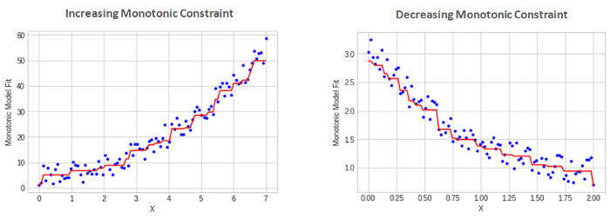
Zig-zaging is removed so that correlation between variables is more consistent

Slide 22
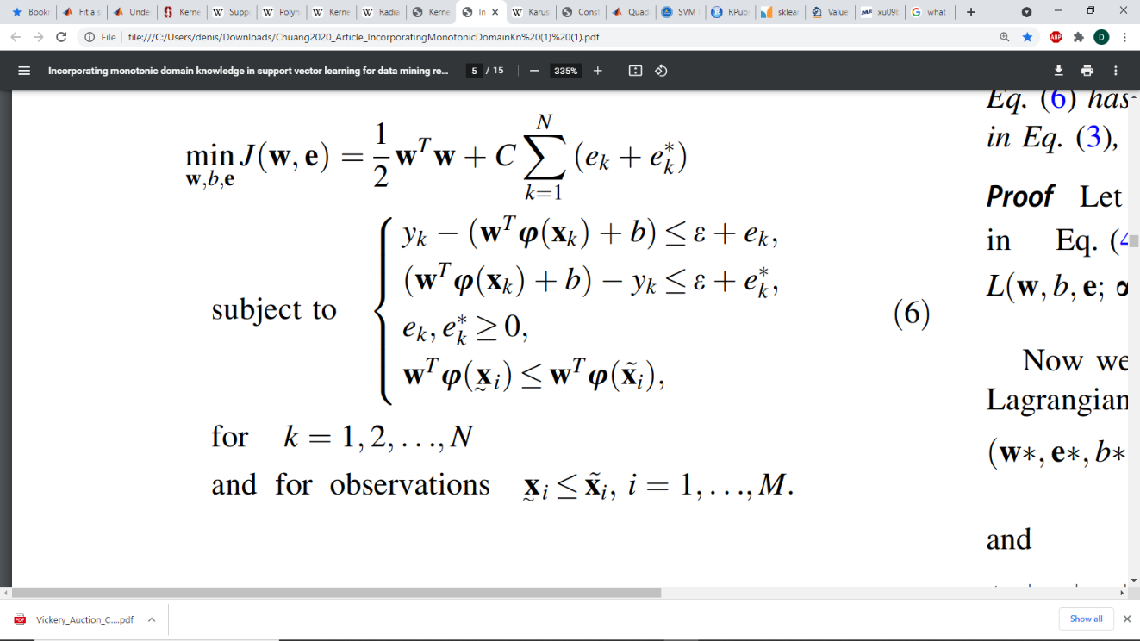


Deriving solution to Monotonicity Constrained SVR
Note that here W is used instead of $β$ as used in my formulation of the problem
Then the problem is trying to preserve the Monotonicity of M observations in the data for which an ordering $\overline{x}≤ \underline{x}$ can be placed on them.

Slide 23
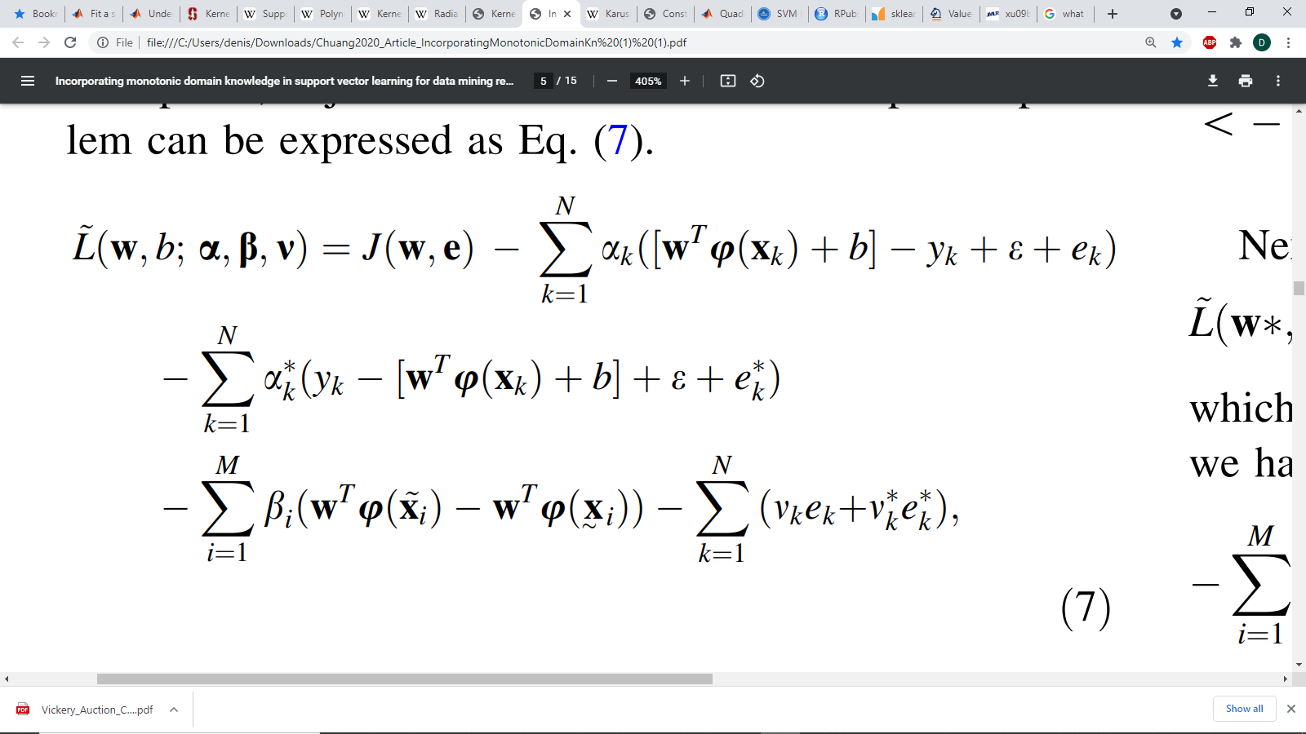
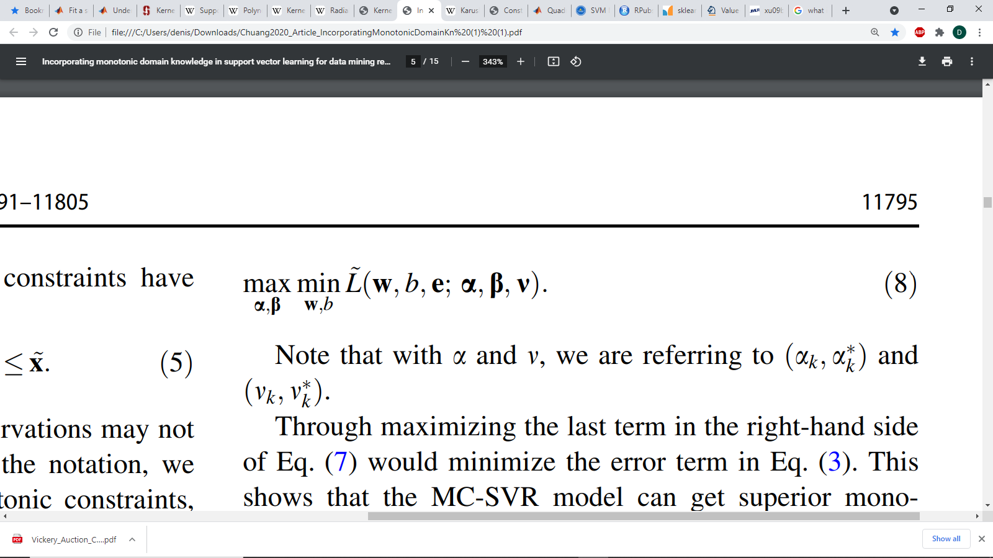

MC-SVR Lagrangian
Where $α,β, and v$ are Lagrange multipliers, and e is the monotonicity error
Then we seek:

Slide 24
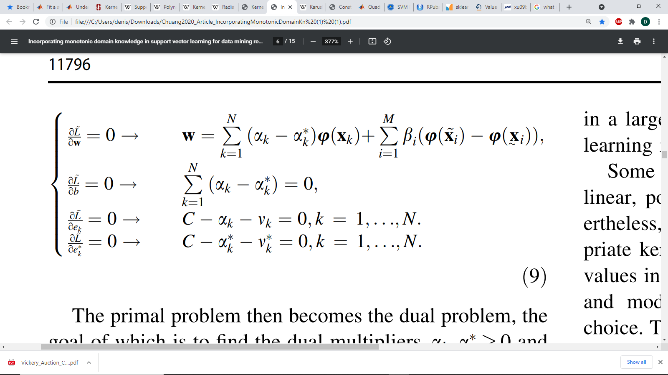
Apply Derivatives

Slide 25
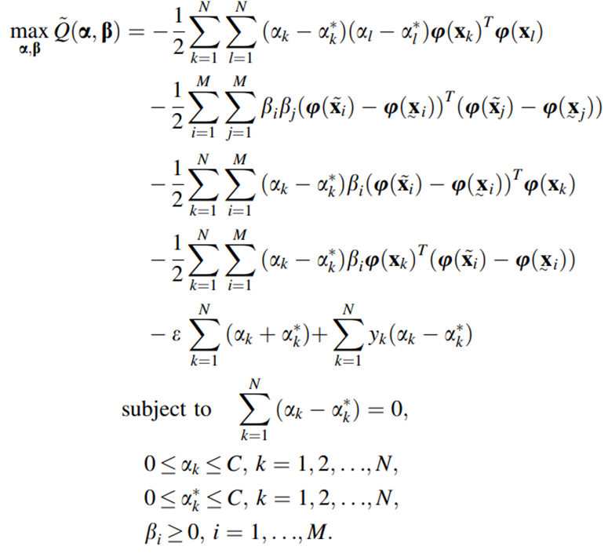
Dual Quadratic Optimization Problem

Slide 26
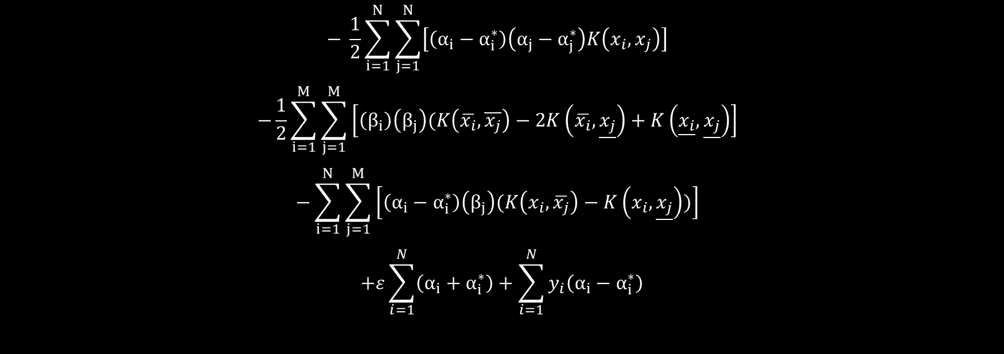
Rewriting the sum in Kernel Form
$$− \frac{1}{2}\sum_{i=1}^{N}{\sum_{j=1}^{N}{\left[\left(α_{i}−α_{i}^{∗}\right)\left(α_{j}−α_{j}^{∗}\right)K\left(x_{i},x_{j}\right)\right]} }$$
$$−\frac{1}{2}\sum_{i=1}^{M}{\sum_{j=1}^{M}{\left[\left(β_{i}\right)\left(β_{j}\right)(K\left(\overline{x_{i}},\overline{x_{j}}\right)−2K\left(\overline{x_{i}},\underline{x_{j}}\right)+K\left(\underline{x_{i}},\underline{x_{j}}\right)\right]} }$$
$$−\sum_{i=1}^{N}{\sum_{j=1}^{M}{\left[\left(α_{i}−α_{i}^{∗}\right)\left(β_{j}\right)(K\left(x_{i},\overline{x_{j}}\right)−K\left(x_{i},\underline{x_{j}}\right))\right]} }$$
$$+ε\sum_{i=1}^{N}{\left(α_{i}+α_{i}^{∗}\right)}+\sum_{i=1}^{N}{y_{i}\left(α_{i}−α_{i}^{∗}\right)}$$

Slide 27
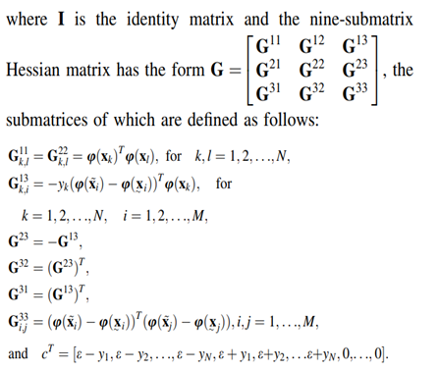
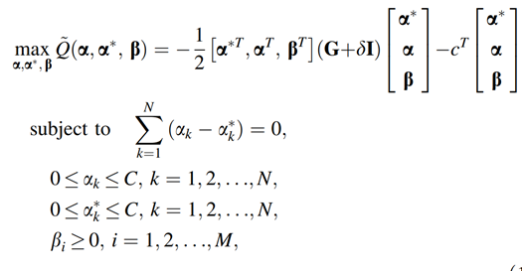
Kernel Formulation
Note it was left off in the paper, but G12 = G21 = 0*G11
i.e., the first two off diagonal terms are 0 matrices of size NxN

Slide 28
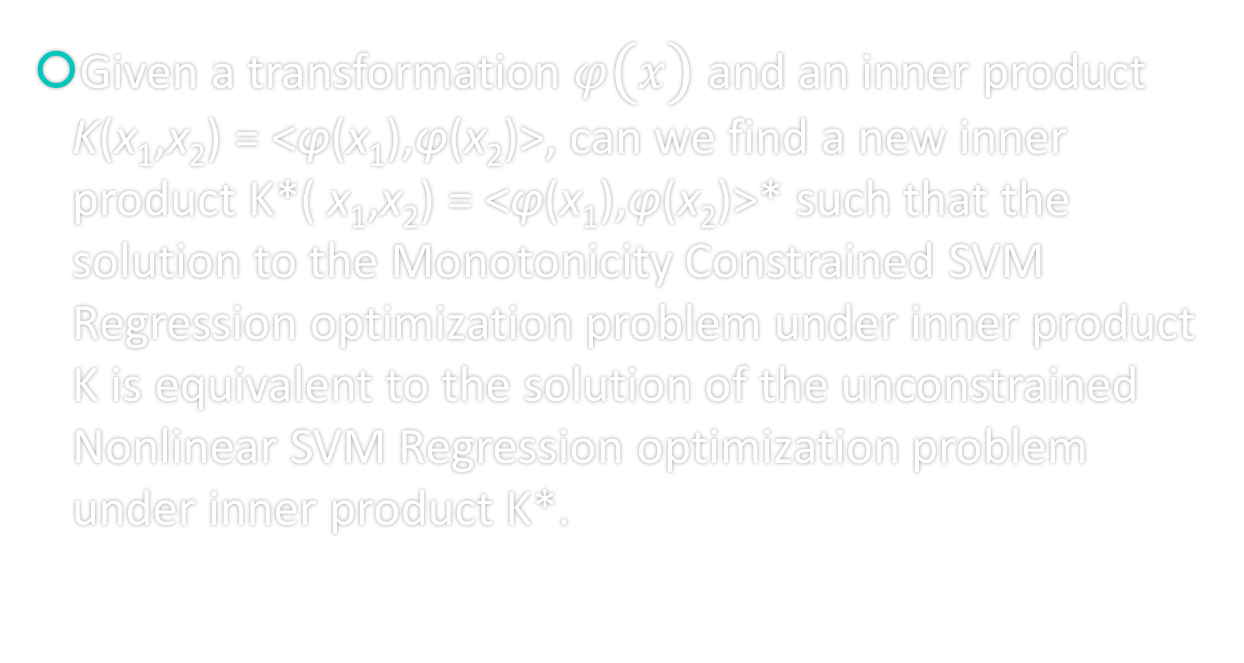
Finally the Problem
Given a transformation $φ\left(x\right)$ and an inner product K(x₁,x₂) = <φ(x₁),φ(x₂)>, can we find a new inner product K*( x₁,x₂) = <φ(x₁),φ(x₂)>* such that the solution to the Monotonicity Constrained SVM Regression optimization problem under inner product K is equivalent to the solution of the unconstrained Nonlinear SVM Regression optimization problem under inner product K*.

Slide 29
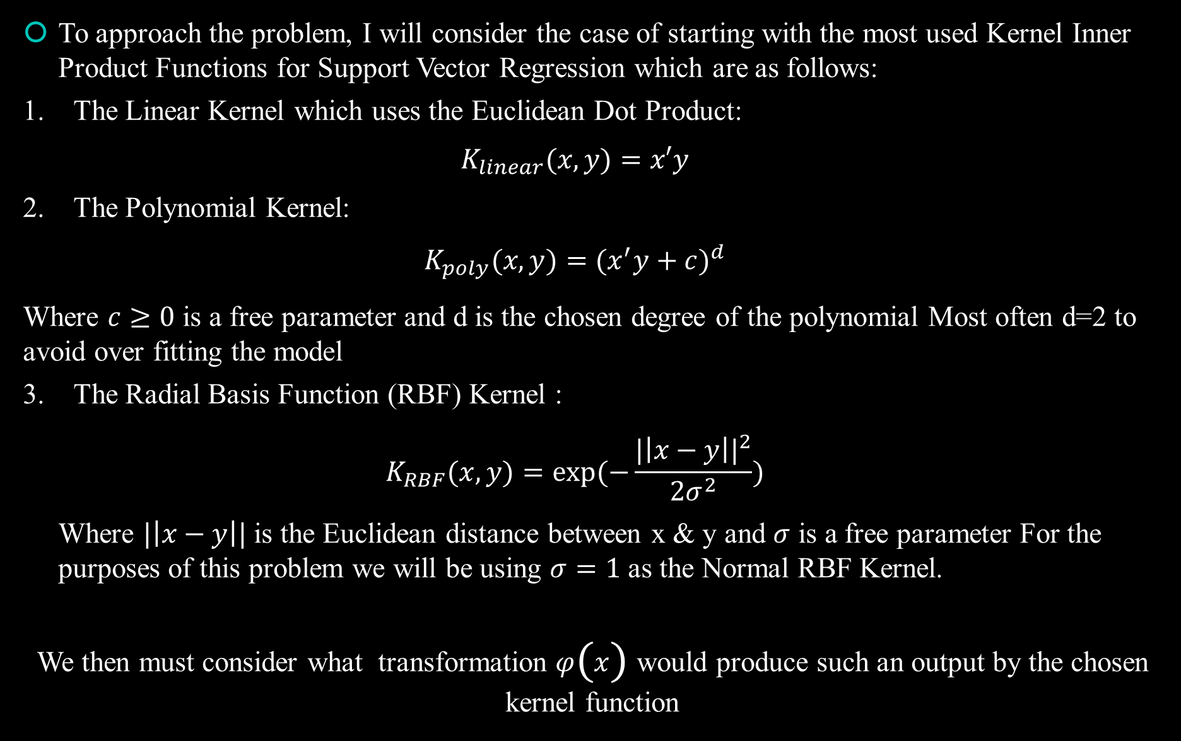
To approach the problem, I will consider the case of starting with the most used Kernel Inner Product Functions for Support Vector Regression which are as follows:
1. The Linear Kernel which uses the Euclidean Dot Product:
$$K_{linear}(x,y)=x′y$$
2. The Polynomial Kernel:
$$K_{poly}(x,y)={(x^{′}y+c)}^{d}$$
Where $c≥0$ is a free parameter and d is the chosen degree of the polynomial Most often d=2 to avoid over fitting the model
3. The Radial Basis Function (RBF) Kernel :
$$K_{RBF}(x,y)=exp⁡(−\frac{|{\left|x−y\right||}^{2}}{2σ^{2}})$$
Where $|\left|x−y\right||$ is the Euclidean distance between x & y and $σ$ is a free parameter For the purposes of this problem we will be using $σ=1$ as the Normal RBF Kernel.
We then must consider what transformation $φ\left(x\right)$ would produce such an output by the chosen kernel function

Slide 30
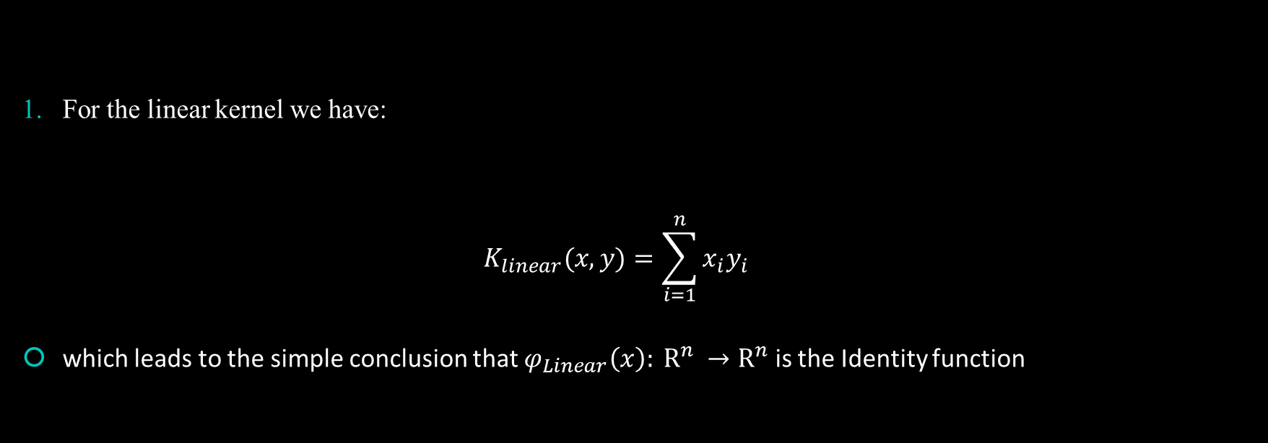
Linear Case
For the linear kernel we have:
$$K_{linear}(x,y)=\sum_{i=1}^{n}{x_{i}y_{i}}$$
which leads to the simple conclusion that $φ_{Linear}\left(x\right): R^{n} →R^{n}$ is the Identity function

Slide 31
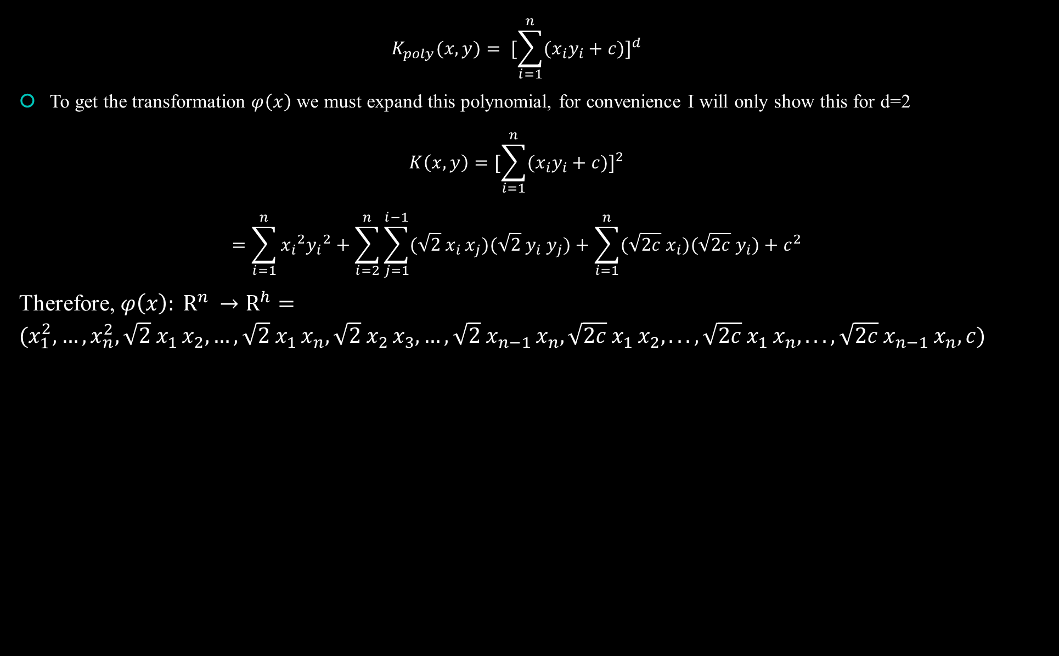
Polynomial Transform
$$K_{poly}(x,y)= {[\sum_{i=1}^{n}{{(x}_{i}y_{i}}+c)]}^{d}$$
To get the transformation $φ\left(x\right)$ we must expand this polynomial, for convenience I will only show this for d=2
$$K\left(x,y\right)={[\sum_{i=1}^{n}{{(x}_{i}y_{i}}+c)]}^{2}$$
$$=\sum_{i=1}^{n}{{x_{i}}^{2}{y_{i}}^{2}}+\sum_{i=2}^{n}{\sum_{j=1}^{i−1}{(\sqrt{2} x_{i }x_{j})(\sqrt{2}{ y}_{i} y_{j})}}+\sum_{i=1}^{n}{(\sqrt{2c}{ x}_{i})(\sqrt{2c}{ y}_{i})}+c^{2}$$
Therefore, $φ\left(x\right): R^{n} →R^{h}=(x_{1}^{2},…,x_{n}^{2},\sqrt{2} x_{1 }x_{2},…,\sqrt{2} x_{1 }x_{n},\sqrt{2} x_{2 }x_{3},…,\sqrt{2} x_{n−1 }x_{n},\sqrt{2c} x_{1 }x_{2},...,\sqrt{2c} x_{1 }x_{n},...,\sqrt{2c} x_{n−1 }x_{n},c)$

Slide 32

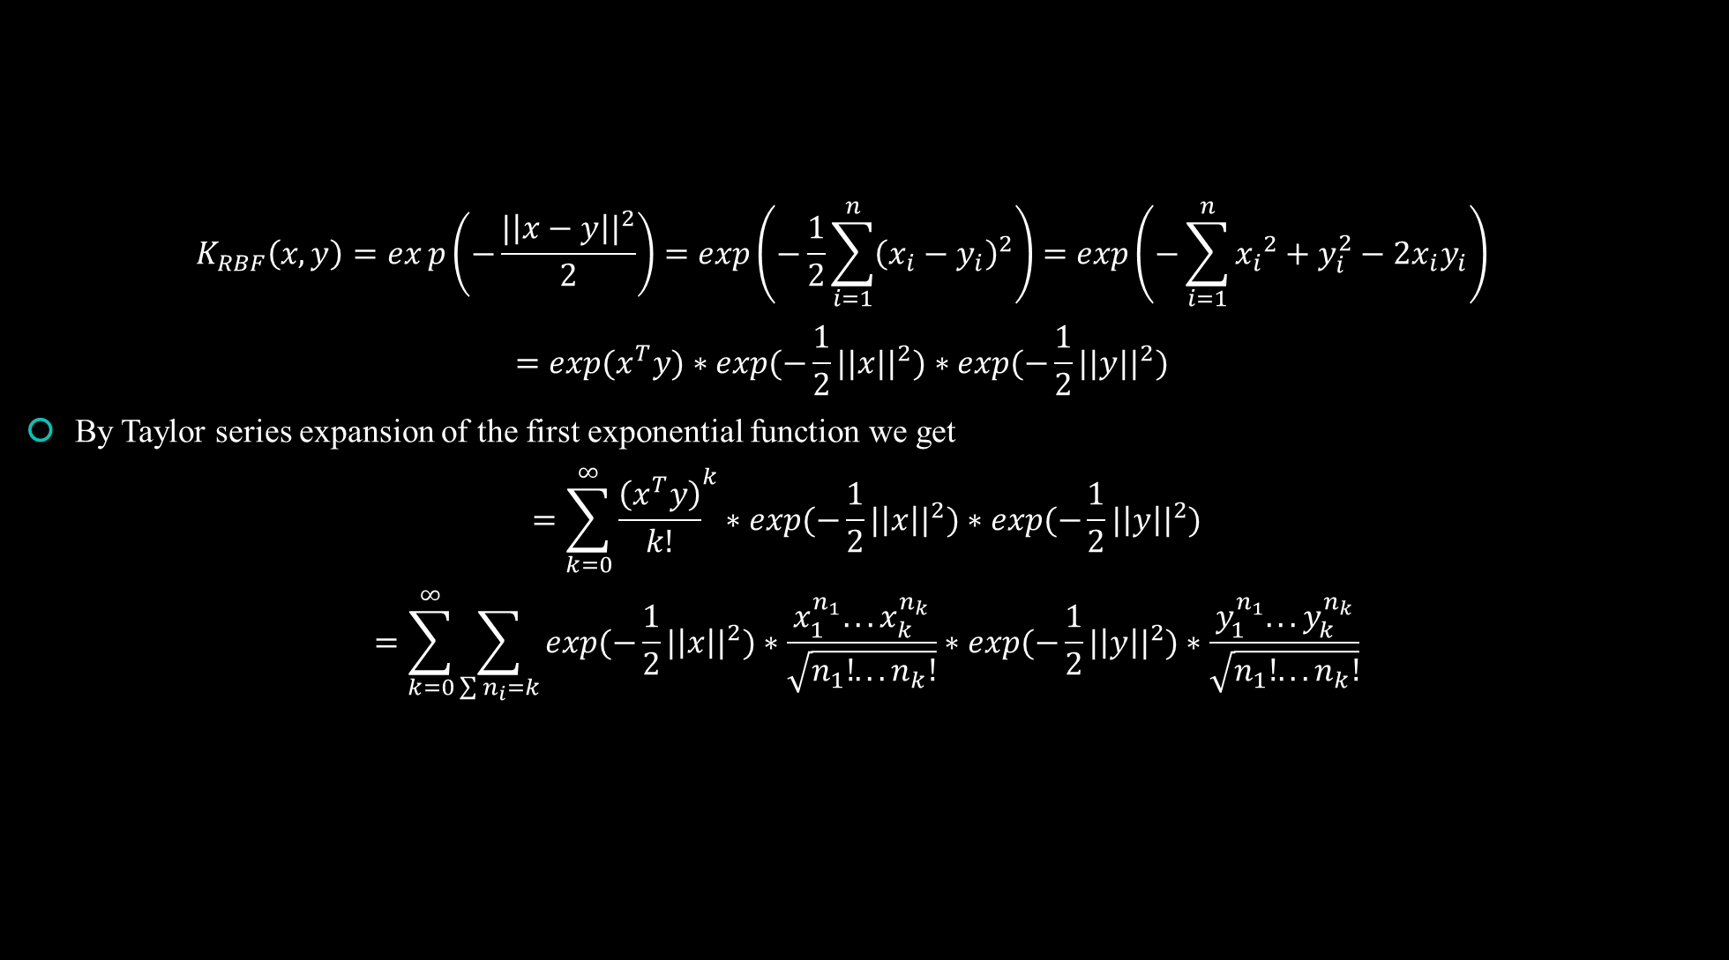
Normal RBK Kernel
$$K_{RBF}\left(x,y\right)=exp\left(−\frac{|{\left|x−y\right||}^{2}}{2}\right)=exp\left(−\frac{1}{2}\sum_{i=1}^{n}{{\left(x_{i}−y_{i}\right)}^{2}}\right)=exp\left(−\sum_{i=1}^{n}{{x_{i}}^{2}+y_{i}^{2}−2x_{i}y_{i}}\right)$$
$$=exp(x^{T}y)∗exp(−\frac{1}{2}||x||^{2})∗exp(−\frac{1}{2}||y||^{2})$$
By Taylor series expansion of the first exponential function we get
$$=\sum_{k=0}^{∞}{{\frac{\left(x^{T}y\right)}{k!}}^{k}}∗exp(−\frac{1}{2}|{\left|x\right||}^{2})∗exp(−\frac{1}{2}|{\left|y\right||}^{2})$$
$$=\sum_{k=0}^{∞}{\sum_{\sum{n_{i}=k}}{exp(−\frac{1}{2}|{\left|x\right||}^{2})∗\frac{x_{1}^{n_{1}}...x_{k}^{n_{k}}}{\sqrt{n_{1}!...n_{k}!}}∗exp(−\frac{1}{2}|{\left|y\right||}^{2})∗\frac{y_{1}^{n_{1}}...y_{k}^{n_{k}}}{\sqrt{n_{1}!...n_{k}!}}}}$$
We find there is no closed form for the transformation $φ\left(x\right)$ in this case as the dimension of the feature space we are mapping into is infinite dimensional. (This should have been obvious as the RBF can be thought of as a polynomial kernel of dimension d=$∞$ when expanded as a Taylor Series)

Slide 33

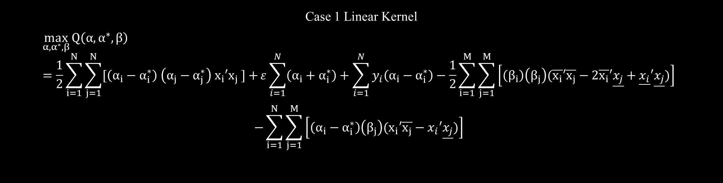

Problem Approach To approach the problem, we must now consider the resulting problem statement for the monotonicity constrained problem for each case
Case 1 Linear Kernel
$$\max_{α,α^{∗},β}{Q\left(α,α^{∗},β\right)}=\frac{1}{2}\sum_{i=1}^{N}{\sum_{j=1}^{N}{[\left(α_{i}−α_{i}^{∗}\right) \left(α_{j}−α_{j}^{∗}\right) x_{i}′x_{j} ]}+}ε\sum_{i=1}^{N}{\left(α_{i}+α_{i}^{∗}\right)}+\sum_{i=1}^{N}{y_{i}\left(α_{i}−α_{i}^{∗}\right)}−\frac{1}{2}\sum_{i=1}^{M}{\sum_{j=1}^{M}{\left[\left(β_{i}\right)\left(β_{j}\right)(\overline{x_{i}}′\overline{x_{j}}−2\overline{x_{i}}′\underline{x_{j}}+\underline{x_{i}}′\underline{x_{j}})\right]} }$$
$$−\sum_{i=1}^{N}{\sum_{j=1}^{M}{\left[\left(α_{i}−α_{i}^{∗}\right)\left(β_{j}\right)(x_{i}′\overline{x_{j}}−x_{i}′\underline{x_{j}})\right]} }$$
subject to the constraints
$$\sum_{i=1}^{N}{\left(α_{i}−α_{i}^{∗}\right)}=0$$
$$∀i:0≤α_{i}≤C$$
$$∀i:0≤α_{i}^{∗}≤C$$
$β_{j}≥0 ,j=1,…,M$
$$\overline{x_{i}}≥ \underline{x_{i}},i=1,…,M$$

Slide 34
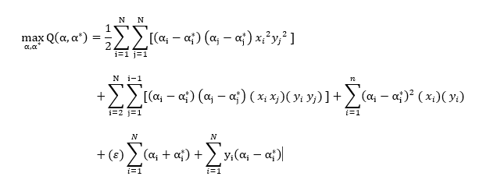

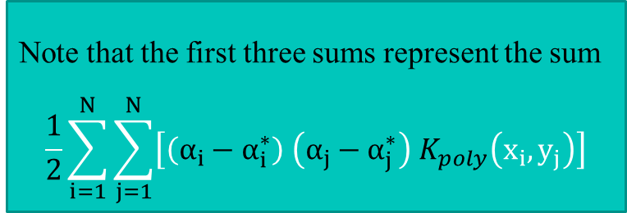
Case 2 Polynomial Kernel of dimension d=2 with c=0: (Unconstrained)
Note that the first three sums represent the sum
$$\frac{1}{2}\sum_{i=1}^{N}{\sum_{j=1}^{N}{\left[\left(α_{i}−α_{i}^{∗}\right) \left(α_{j}−α_{j}^{∗}\right) K_{poly}\left(x_{i},y_{j}\right)\right]}}$$
$$\sum_{i=1}^{N}{\left(α_{i}−α_{i}^{∗}\right)}=0$$
$$∀i:0≤α_{i}≤C$$
$$∀i:0≤α_{i}^{∗}≤C$$
Subject to constraints

Slide 35

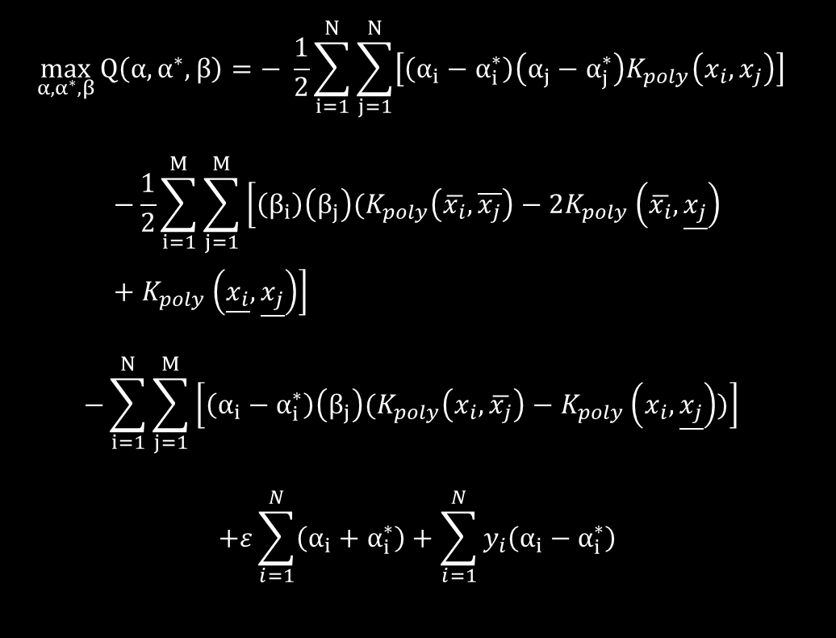
The unconstrained problem would thus require writing out:
$$\max_{α,α^{∗},β}{Q\left(α,α^{∗},β\right)}=− \frac{1}{2}\sum_{i=1}^{N}{\sum_{j=1}^{N}{\left[\left(α_{i}−α_{i}^{∗}\right)\left(α_{j}−α_{j}^{∗}\right)K_{poly}\left(x_{i},x_{j}\right)\right]} }$$
$$−\frac{1}{2}\sum_{i=1}^{M}{\sum_{j=1}^{M}{\left[\left(β_{i}\right)\left(β_{j}\right)(K_{poly}\left(\overline{x_{i}},\overline{x_{j}}\right)−2K_{poly}\left(\overline{x_{i}},\underline{x_{j}}\right)+K_{poly}\left(\underline{x_{i}},\underline{x_{j}}\right)\right]} }$$
$$−\sum_{i=1}^{N}{\sum_{j=1}^{M}{\left[\left(α_{i}−α_{i}^{∗}\right)\left(β_{j}\right)(K_{poly}\left(x_{i},\overline{x_{j}}\right)−K_{poly}\left(x_{i},\underline{x_{j}}\right))\right]} }$$
$$+ε\sum_{i=1}^{N}{\left(α_{i}+α_{i}^{∗}\right)}+\sum_{i=1}^{N}{y_{i}\left(α_{i}−α_{i}^{∗}\right)}$$
subject to the constraints
$$\sum_{i=1}^{N}{\left(α_{i}−α_{i}^{∗}\right)}=0$$
$$∀i:0≤α_{i}≤C$$
$$∀i:0≤α_{i}^{∗}≤C$$
$β_{j}≥0 ,j=1,…,M$ $\overline{x_{i}}≥ \underline{x_{i}},i=1,…,M$
To expand this out fully would clearly become a nightmare to write down and it is clear why the kernel trick was developed.

Slide 36
Further From The Truth Than When We Began
From this we can see that although the problem looked very close to a solution in the outset, there is still a gap in the mathematical framework in this area to make a conclusive connection between the unconstrained SVR problem and the Monotonicity problem based on transformations to the kernel. If one seeks to embark on solving this problem themselves, I recommend the following paper:
“Kernel Methods In Machine Learning” By Thomas Hofmann, Bernhard Schölkopf & Alexander J. Smola, which focuses on SVR for the majority of the paper (however it also discusses Principal Component Analysis toward the end) and formulates the useful properties of kernel functions and the kernel trick.

Slide 37
Importance of Monotonicity and this Problem in General:
Monotonicity constrained SVR problems provide better estimates for nonlinear relations between data and response such as sinusoidal relationships between data and response as shown in the paper using the MSE as a measurement of model accuracy on synthetic data
We are attempting to incorporate prior knowledge about a relationship between the data and the response variable so that these relationships are preserved in our model. In other words, we are attempting to build a model taking a Bayesian approach to preserve previous insight on the data
Support Vector Regression is regarded as a highly successful regression technique, however incorporating previously known relations in data into models is not so easy

Slide 38
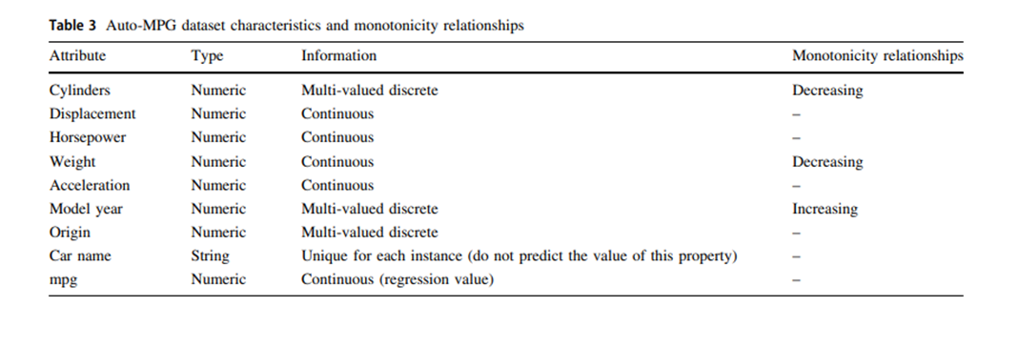
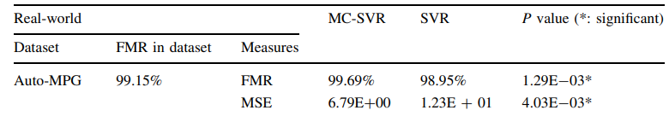
MC-SVR on mpg data
AutoMPG dataset from the UCI Machine Learning Repository
training a monotonicity constrained SVR model led to better predictions on the true MPG of a car using the following relations:
than an unconstrianed SVR model with the following results:

Slide 39
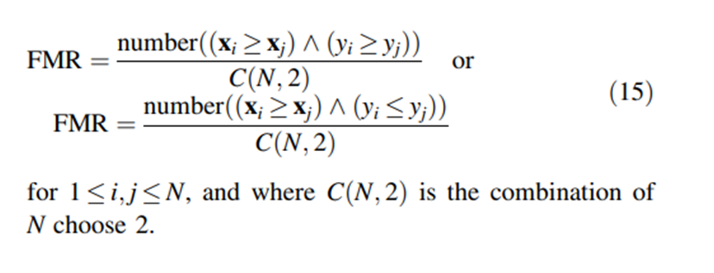
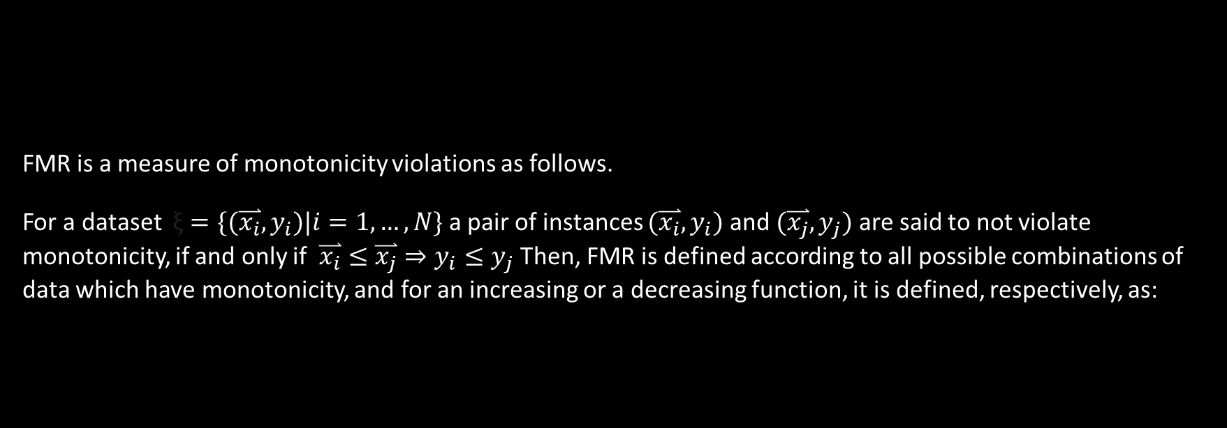
FMR
FMR is a measure of monotonicity violations as follows.
For a dataset $ξ=\{(\overset{⃑}{x_{i}},y_{i})|i=1,…,N\}$ a pair of instances $(\overset{⃑}{x_{i}},y_{i})$ and $(\overset{⃑}{x_{j}},y_{j})$ are said to not violate monotonicity, if and only if $\overset{⃑}{x_{i}}≤\overset{⃑}{x_{j}}⇒y_{i}≤y_{j}$ Then, FMR is defined according to all possible combinations of data which have monotonicity, and for an increasing or a decreasing function, it is defined, respectively, as:

Slide 40
Drawbacks of Monotonicity Constraints
Currently, Monotonicity constraints increase time complexity for a solution
As put in the paper “Another future work concerns the scalability issue of the RMC-SVR. The temporal and spatial complexity of the RMC-SVR is determined by the quadratic programming, which can be solved in polynomial time with respect to N + M; the sum of the numbers of data and constraints. Similar to traditional SVRs, when the data scale increases, quadratic programming becomes intractable”
Applying multiple monotonicity constraints is not feasible in most cases as the problem is not parallelized and thus the solution will take up extensive amounts of memory and time to compute

Slide 41
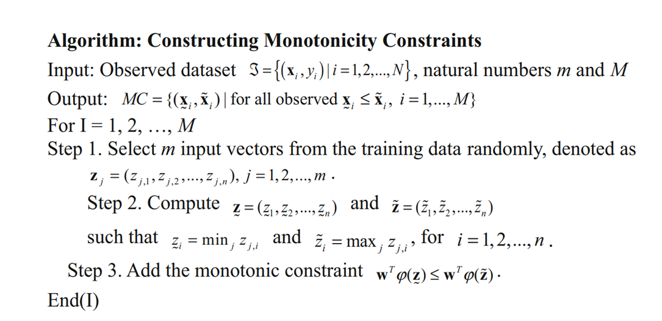
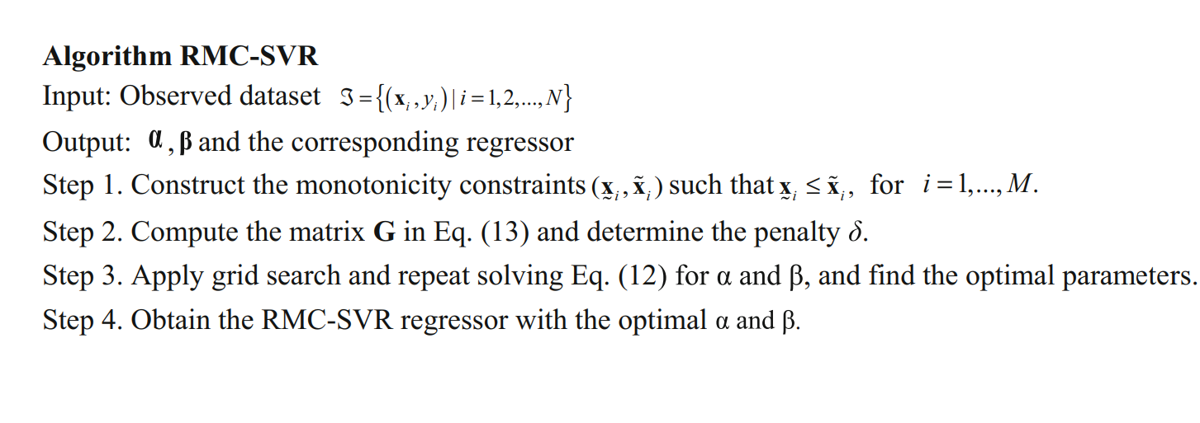
Monotonicity Constraints Applied to Stock Data:

Slide 42
R Code SVR
After spending many hours coding both a normal SVR model and enhancing the model to run RMC-SVR as described above, I am unable to find a solution to the RMC-SVR problem using quadratic programing in R on the log-return dataset, possibly due to an, error, but worse, using Matlab as described in the paper, I am unable to achieve the results published in the paper, using the regression modeling statistical app on the mpg dataset using the best known optimization techniques I was unable to get an MSE less than 84 while they report an MSE of 12 meaning they have made some mistake in their unpublished code.

Slide 43
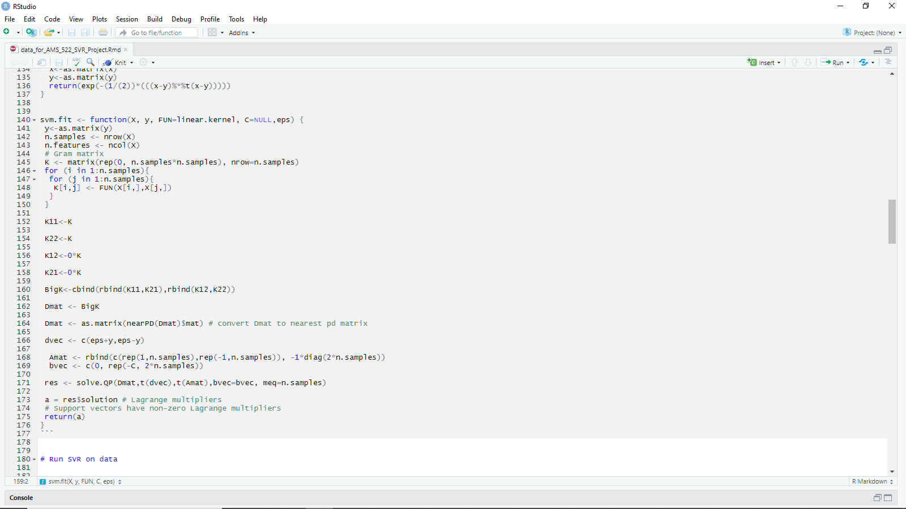

Slide 44
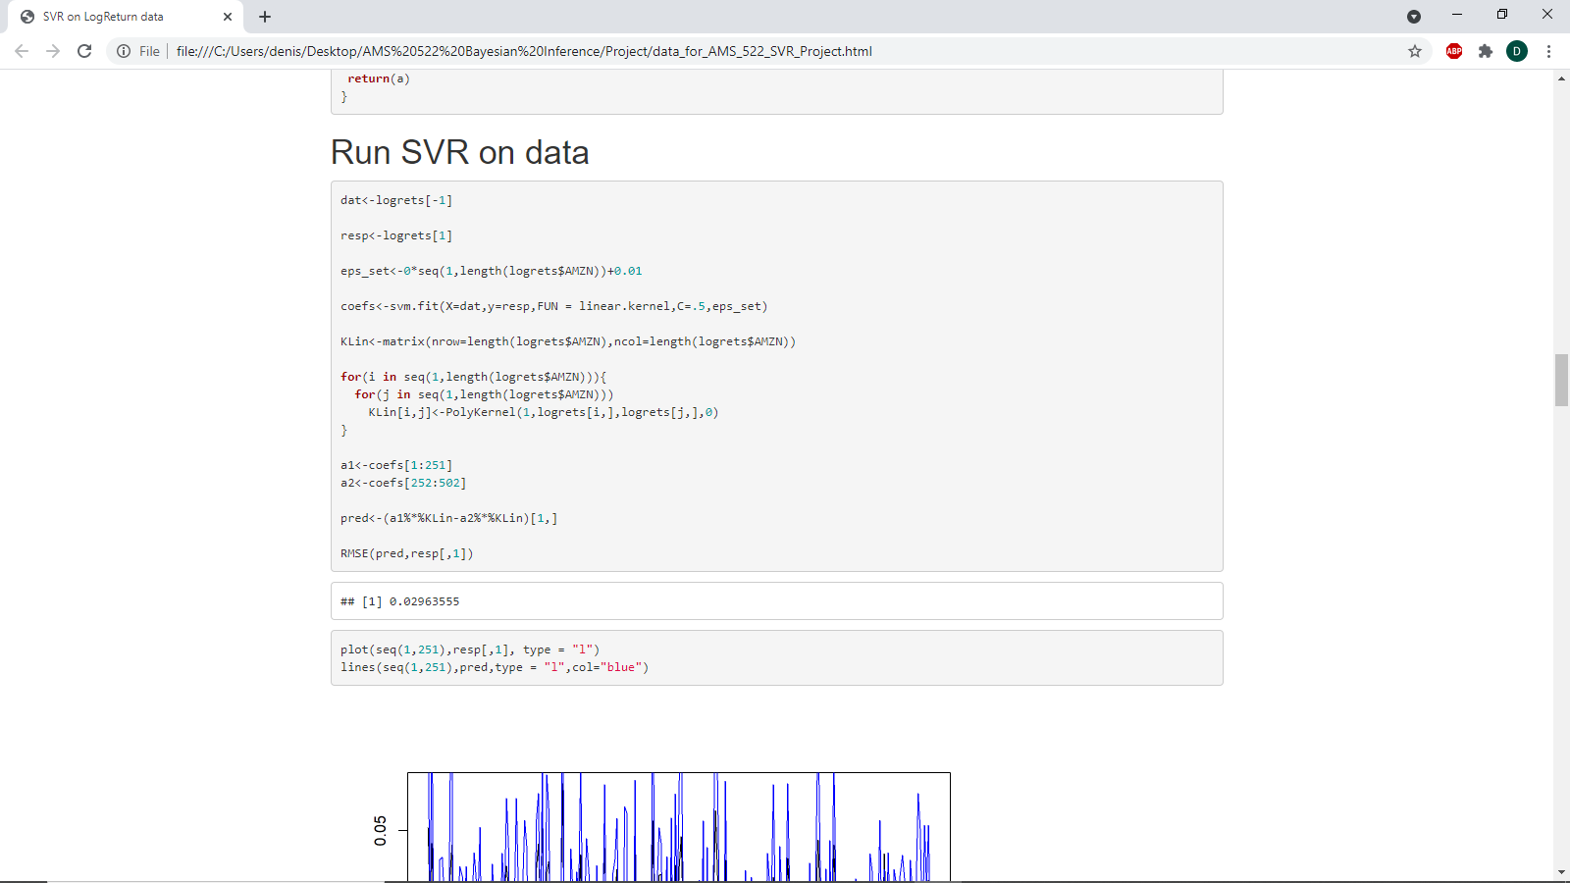

Slide 45
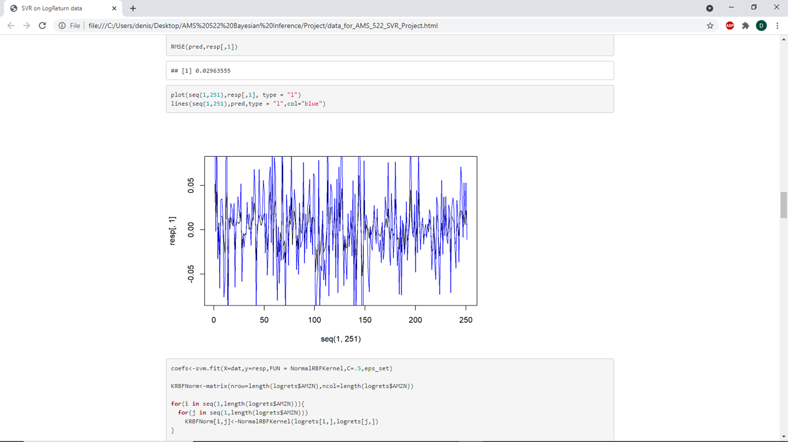

Slide 46
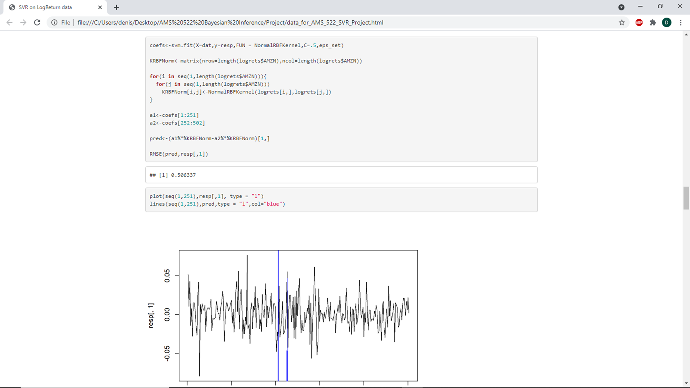

Slide 47
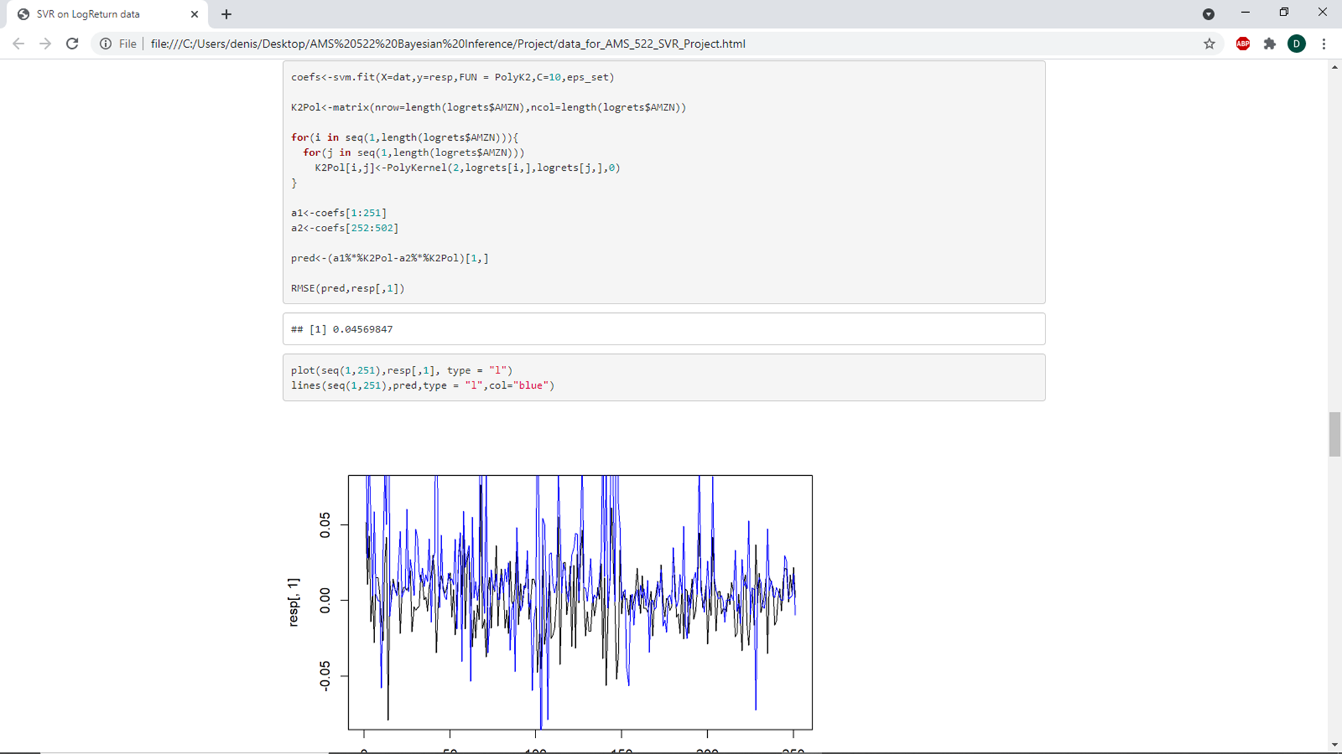

Slide 48
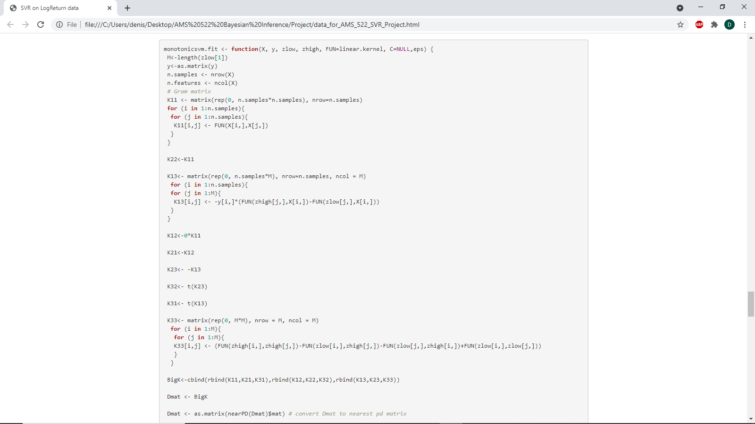

Slide 49
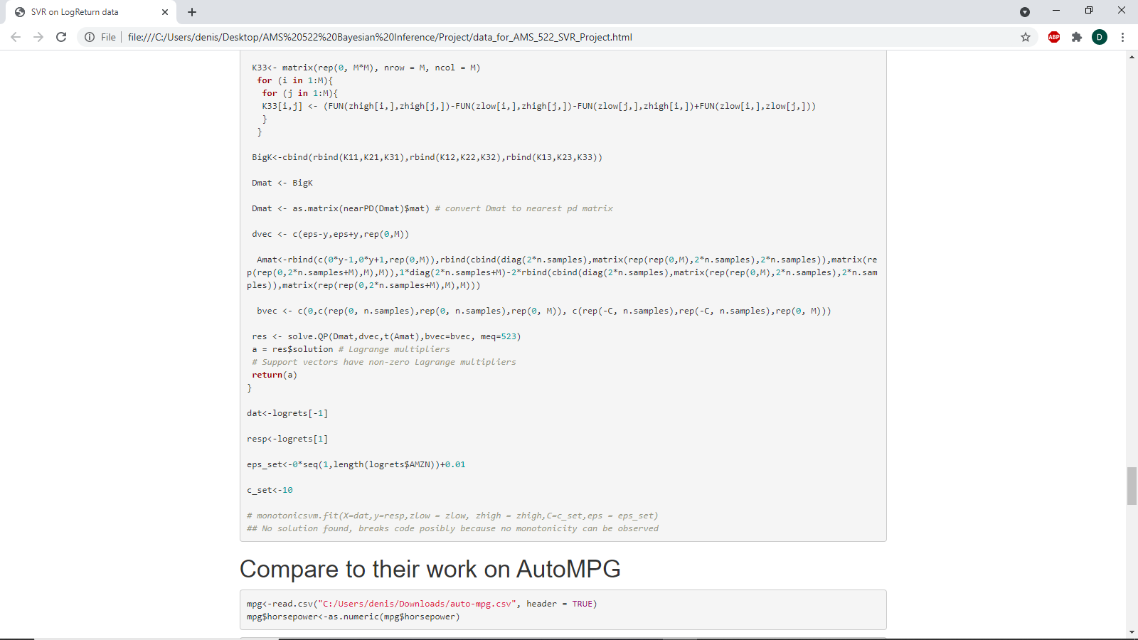

Slide 50
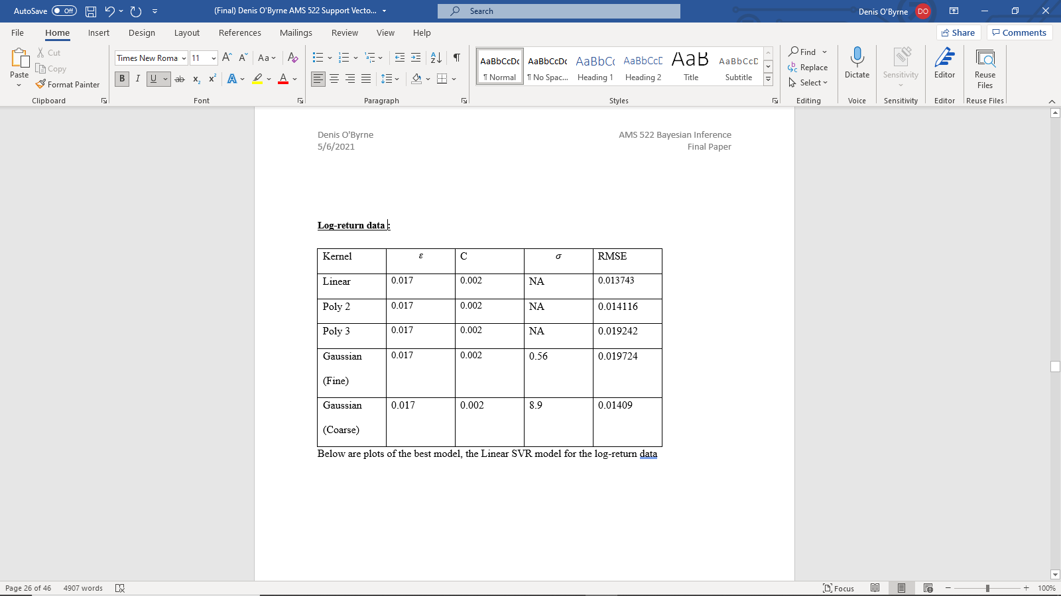
SVR on Log-Return Data In MatLab

Slide 51
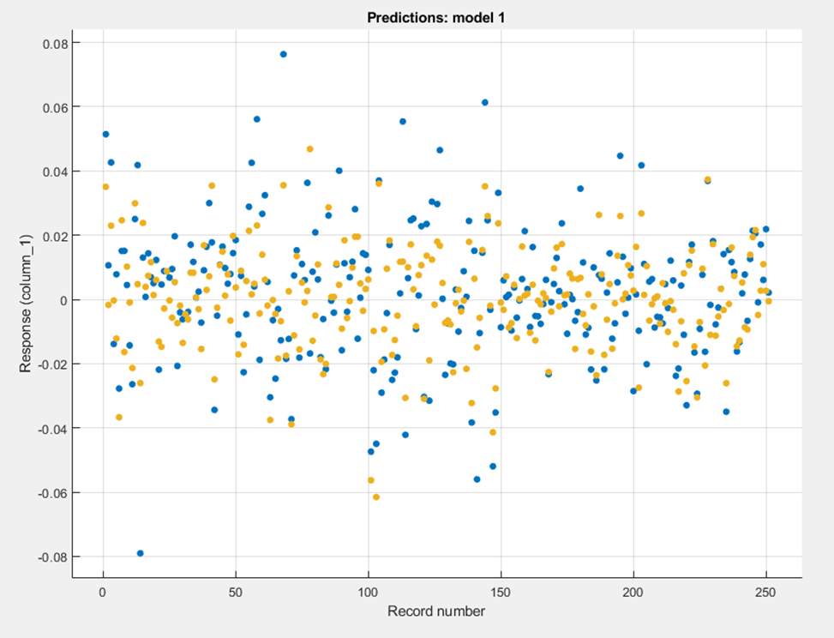
Linear Model on Stock Data MatLab

Slide 52


Slide 53
Can we reproduce the results on autompg

Slide 54


Slide 55

Plot of SVR hyperparameter optimization MSE

Slide 56
MSE Minimization Plot
This plot gives us very valuable insight for a few things. As can be seen in my coded SVR in R, making a poor choice of hyperparameters, wildly destroyed the MSE of my model which in R I had found an RMSE of close to 11,000. This shows that although SVR can be a useful tool, it is necessary to use insightful hyper-parameters
More importantly, this plot proves devastating for the original problem we set out to solve with this paper. If we take the results of the MC-SVR paper on this same data to be truthful (I state this in such a way because it cannot be reproduced)
then it would seem unlikely that if there were a solution to the Problem, ie that there exists some kernel for which the results are equivalent to the MC-SVR problem then it should be possible to find the kernel, or at least a kernel with parameters which produce results with close to the same output but we can see that using the unconstrained SVR approach we were not able to get to an MSE below 84 while the paper reports an astounding MSE of 6 on this same dataset using the MC-SVR approach while I had let my computer search for optimal parameters for at least 10 minutes with a rate of about 4,000 kernels checked per second
For this reason, I would say that it seems unlikely that the problem has a solution (assuming the results reported are true). I would compare to the R model, but this again found no solution, meaning I may have a mistake in the code somewhere

Slide 57

SVR Model Clustering
One last thing I noted in my research is that SVR models tend to produce estimated predictions in distinct clusters, which is something I had never seen before in a predicted vs actual plot before. This is related to the epsilon hinge loss as once we exceed a certain distance from a predicted mean we move to a new clustering of predictions it would seem

Slide 58

Conclusions
We have seen that Support Vector Regression can be an extremely efficient method for developing a model, however it is clear none of this work could be possible if it had not been for the strengths of the Kernel Trick to avoid having to consider hyper dimensional transformation functions $φ\left(x\right)$
From this augmented view of the inner product on these hyper-spaces, we can see that it seems feasible that one should be able to use kernel functions to avoid having to work with large numbers of additional constraints, which can increase computation time and memory required to solve by the cube of the sum of the number of constraints and the number of data observations
With the work here I hope it is clear that if the problem does have a solution, it will require making a clever trick with the base kernel functions. If one were to solve this, then it would be possible to run SVR while incorporating prior knowledge on the data more easily by simply updating the kernel choice.

